Slide 1
Ice Cream Trucks
MTA Turnstile Exploratory Data Analysis

Slide 2
Back story
- Ice cream Trucks company want to increase the sales of the ice cream
trucks by identifying the busiest stations and determining the best located for the ice cream trucks.
- The project period is four months (May, June, July, August) of the summer period in 2018, and to achieve increase the sales well analyze the stations data in New York City.

Slide 3
Tools
Terminology
Libraries
Jupter Notebook, Python
Numpy, Matplotlib, Pandas, SqlAlshema, Seaborn

Slide 4
Workflow
Read Data set MTA from The link
Define heist traffic station
Step 1
Step 2
Step 3
Step 4
Clean data set
Connect data set with SQLite

Slide 5
Clean Data set
01
Check of NAN
Drop duplicates
02
Minimum and Maximum of numerical values
Outlires
03
04

Slide 6
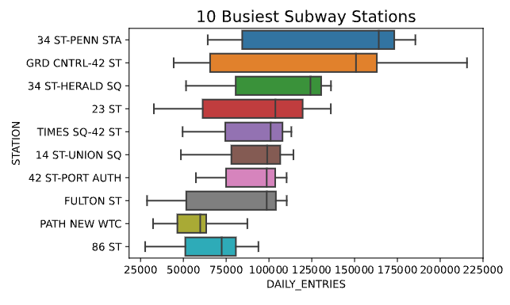
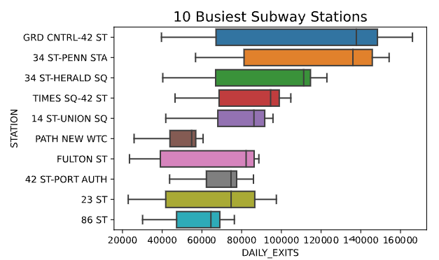
Heist Traffic Station with Daily_Entries
Heist Traffic Station with Daily_Exits

Slide 7
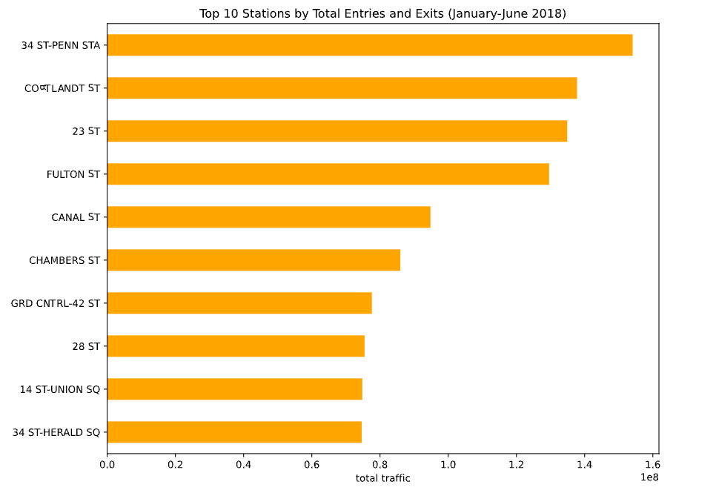
Heist Traffic Station

Slide 8
Conclusion
It is preferred to locate Ice Cream trucks at the top 10 crowded stations and
provide the most famous flavors in New York.
Strawberry
Chocolate
Candy
Candy
Pistachio

Slide 9
Future Work
As a result, the trucks will be located to the 10 busiest stations to increase sales of the
Ice Cream Trucks can be set based on when the temperatures are rising and during the rush hours.
80%
65%
75%
90%

Slide 10
Thank you
By Shahad Aati

